Slide 1


[xTx]

Slide 2

Sparrow Wallet
[xTx]
Desktop on-chain Bitcoin wallet.
Designed for Everyone.
Focus on UTXO management and Transactions.
Seamless Hardware Wallet Integration.
Open Source!!!

Slide 3
Sparrow Wallet
[xTx]
Flexible Network Options.
Smooth Tor connection.
Wallet Label Export format (BIP329).
Advanced Features:
        PSBT.
        Fee Control.
        Privacy Tools *.

Slide 4
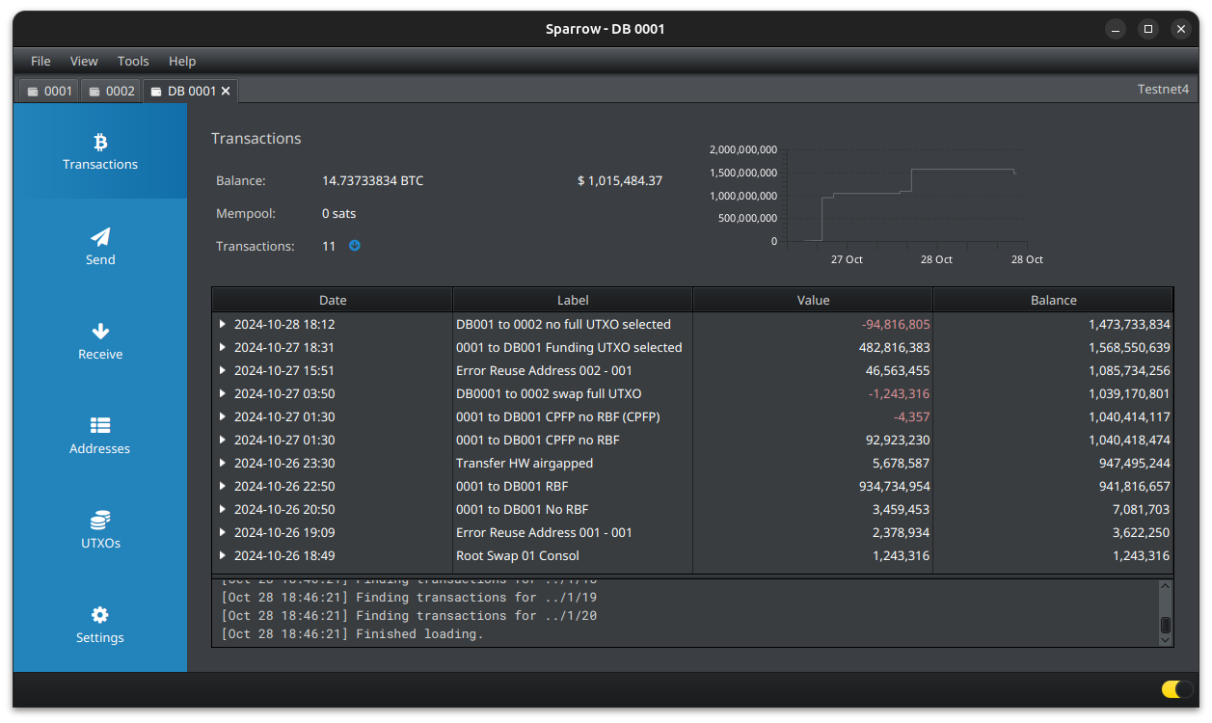
[xTx]

Slide 5
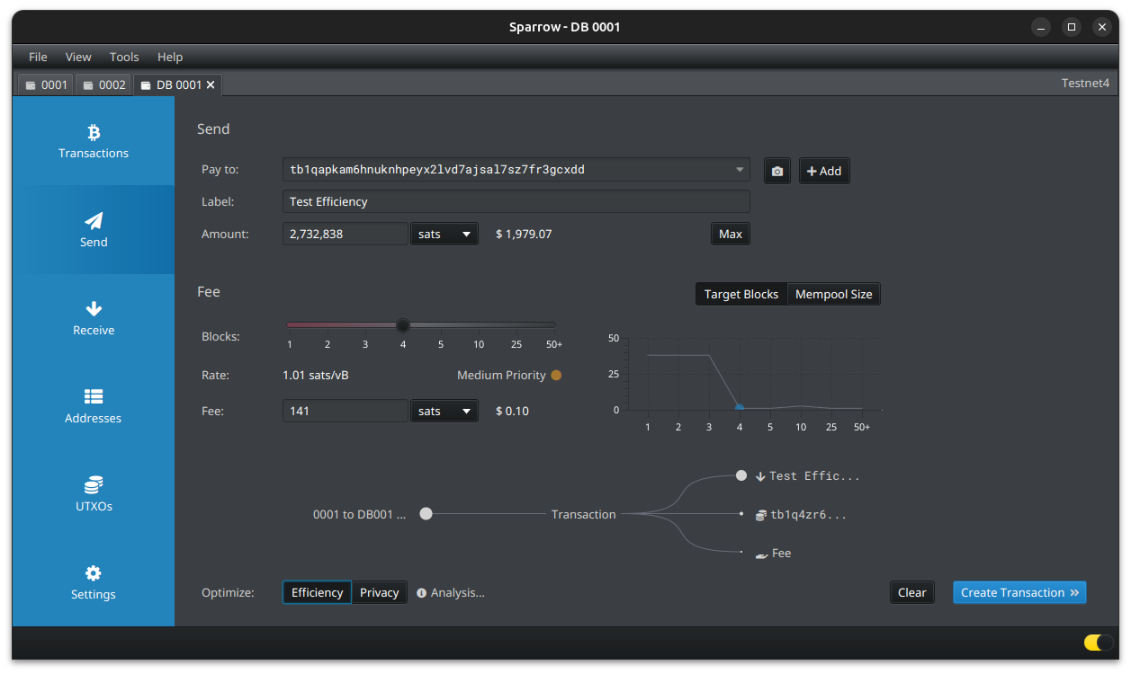
[xTx]

Slide 6
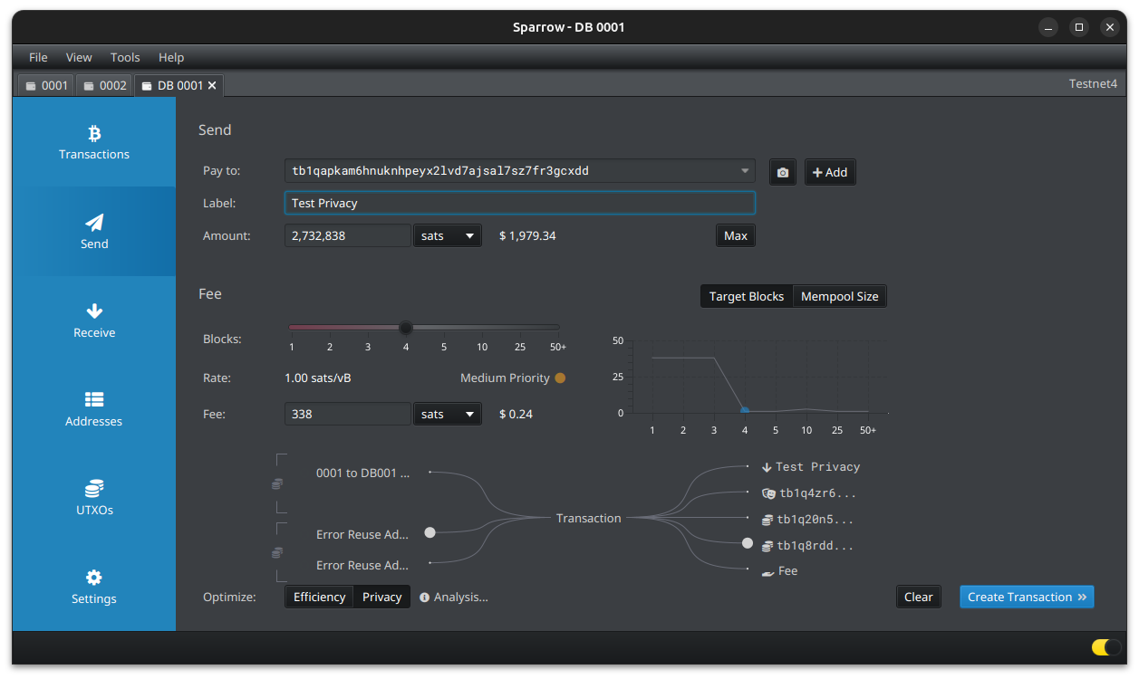
[xTx]

Slide 7
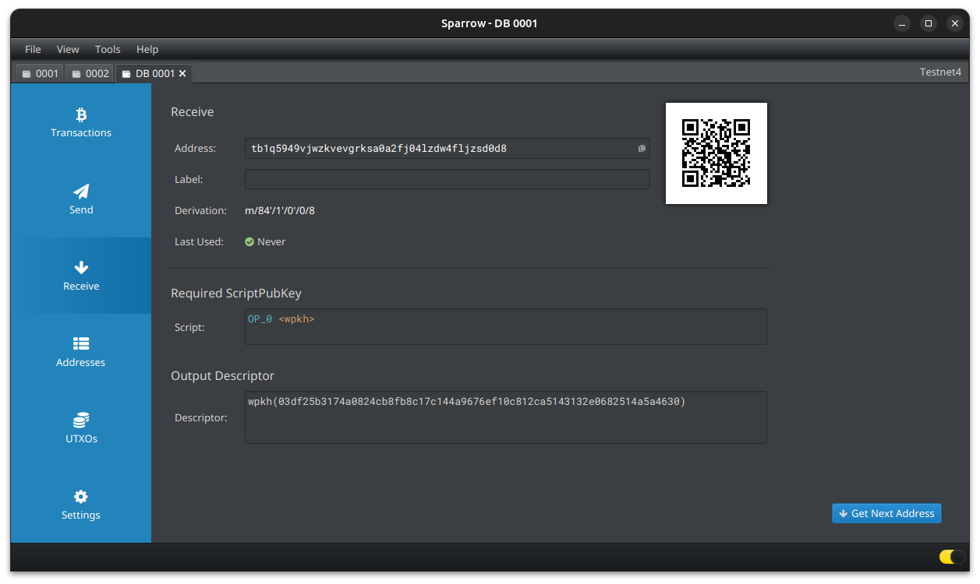
[xTx]

Slide 8
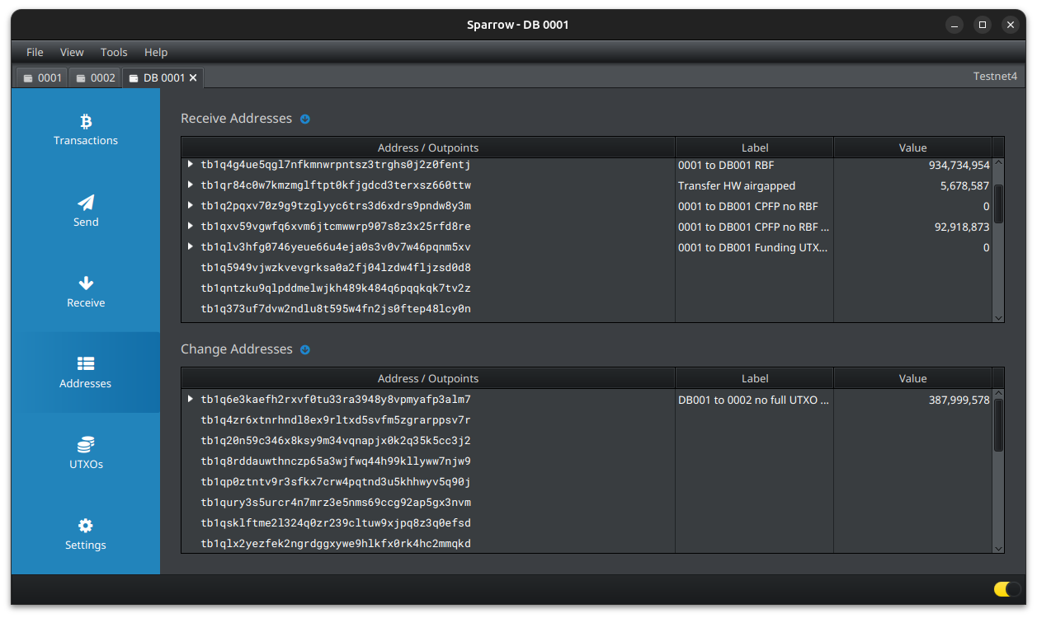
[xTx]

Slide 9
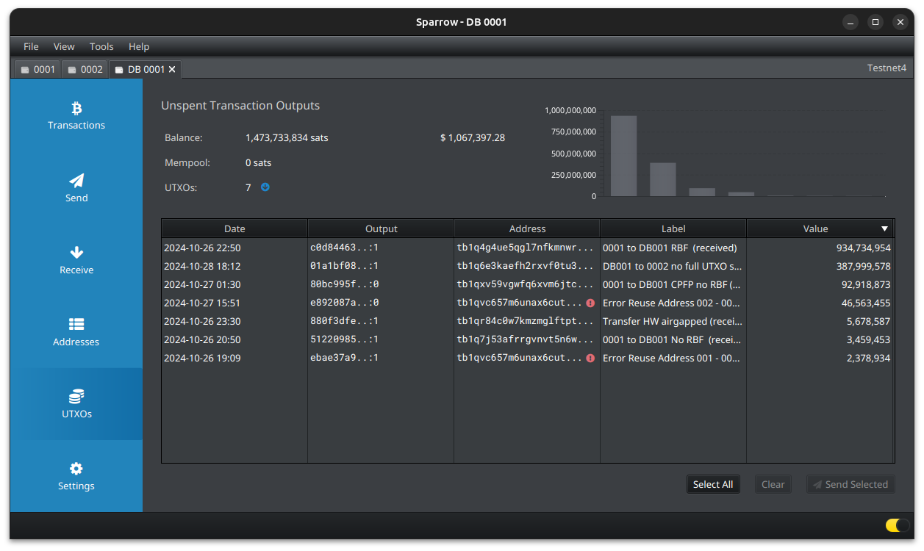
[xTx]

Slide 10
[xTx]
UTXO management

Slide 11
[xTx]
A UTXO, is a portion of Bitcoin that's been received but not yet spent.
Once a UTXO is used as an input, it cannot be used again in another transaction.
A transaction involves inputs (UTXOs being spent) and outputs (new UTXOs created).

Slide 12
[xTx]
Label your UTXOs.
Consolidate when fees are low. (Privacy concerns).
Future spending plans (what size and how many UTXOs you want to end up with).
Withdraw from exchanges in larger amounts.

Slide 13
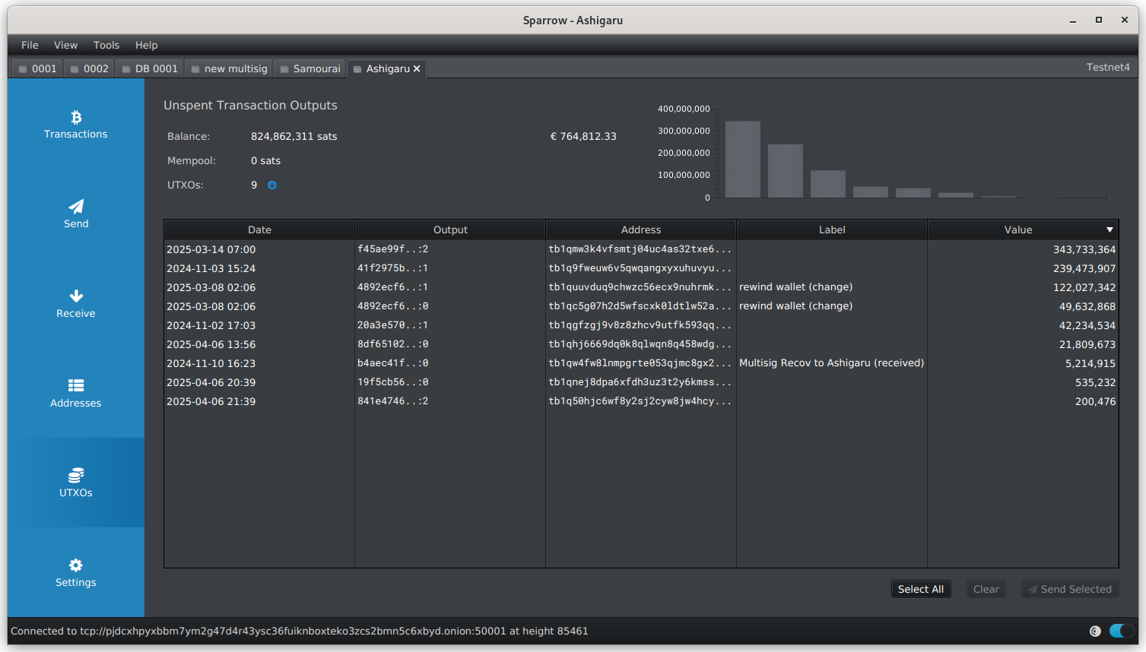
[xTx]

Slide 14
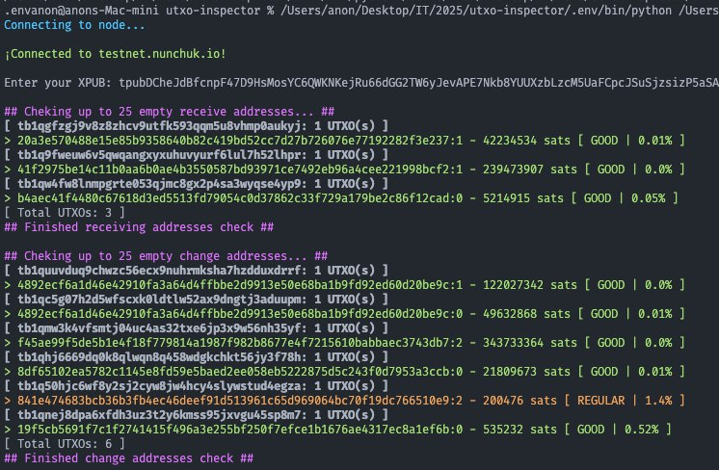
[xTx]

Slide 15
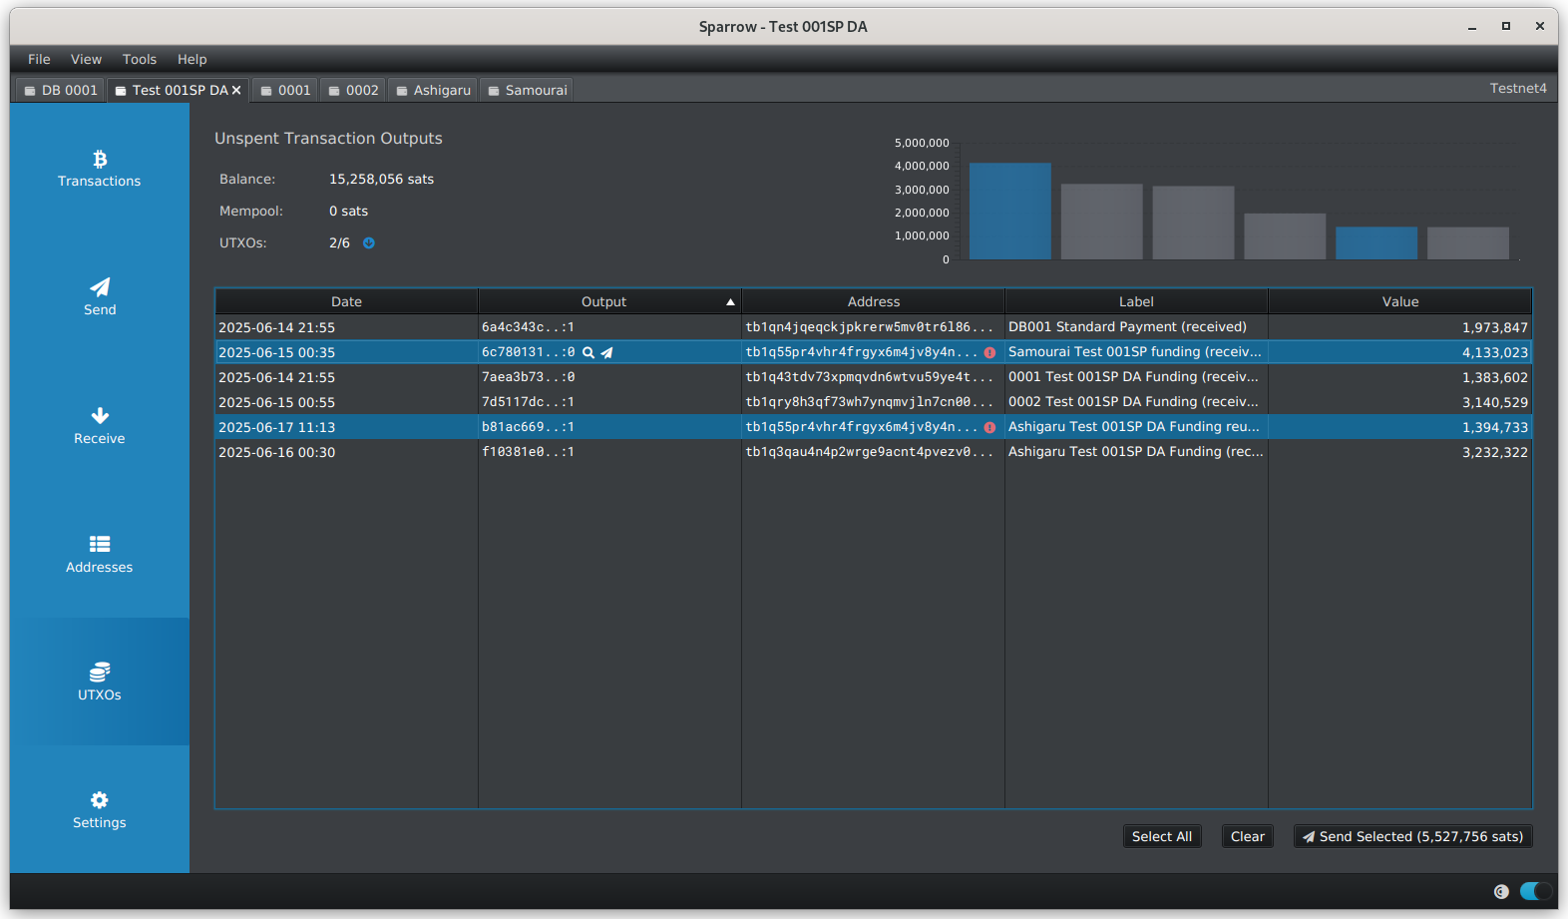
[xTx]

Slide 16
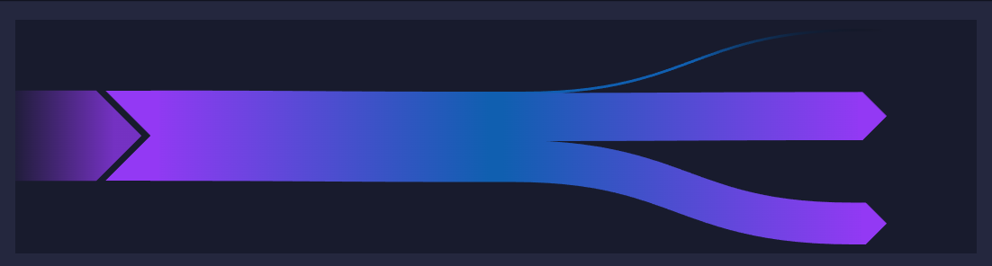
Standard payment
One input - two outputs (payment and change)
[xTx]

Slide 17
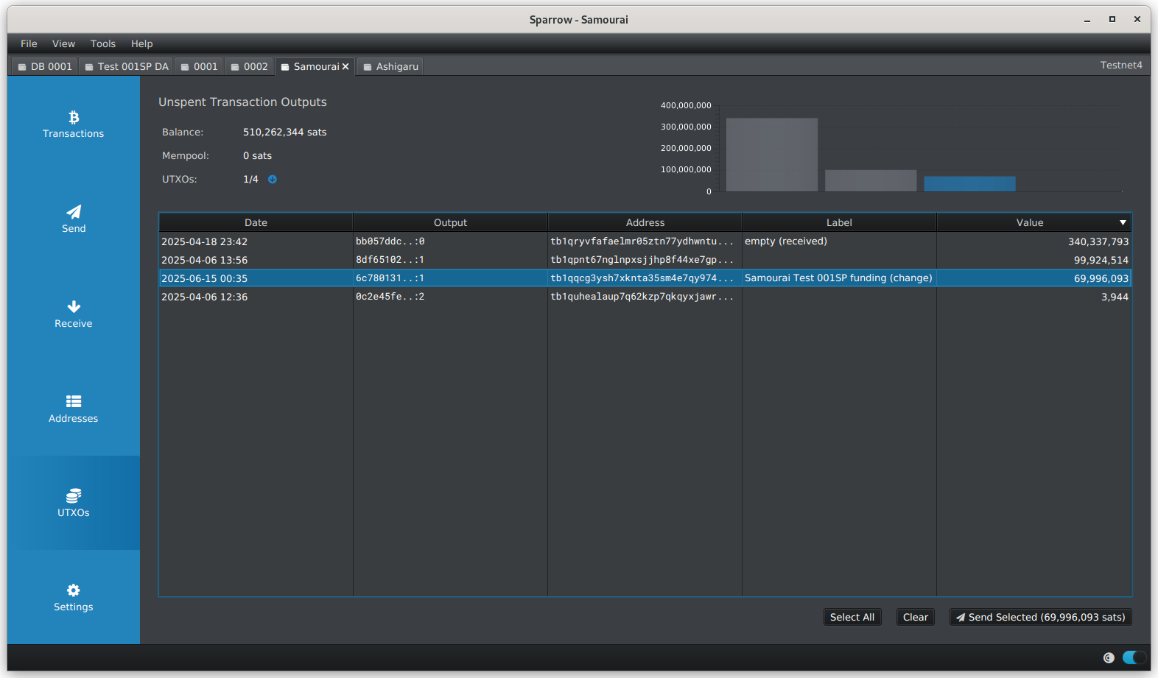
[xTx]

Slide 18
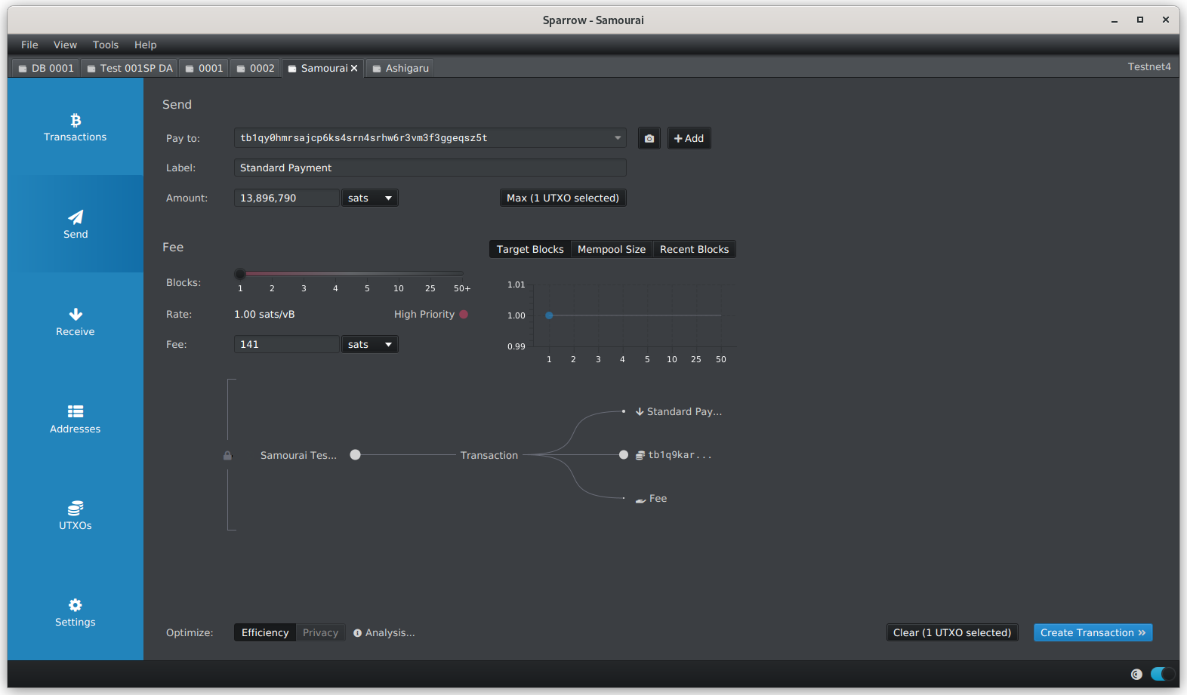
[xTx]

Slide 19
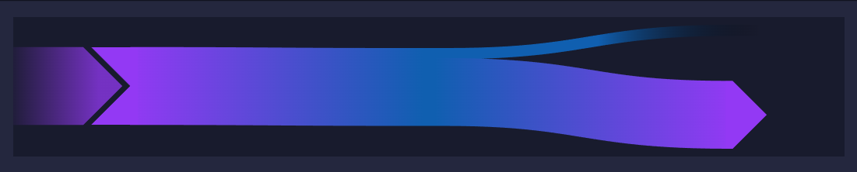
Sweep payment
Self transfer. One input - One output
[xTx]

Slide 20
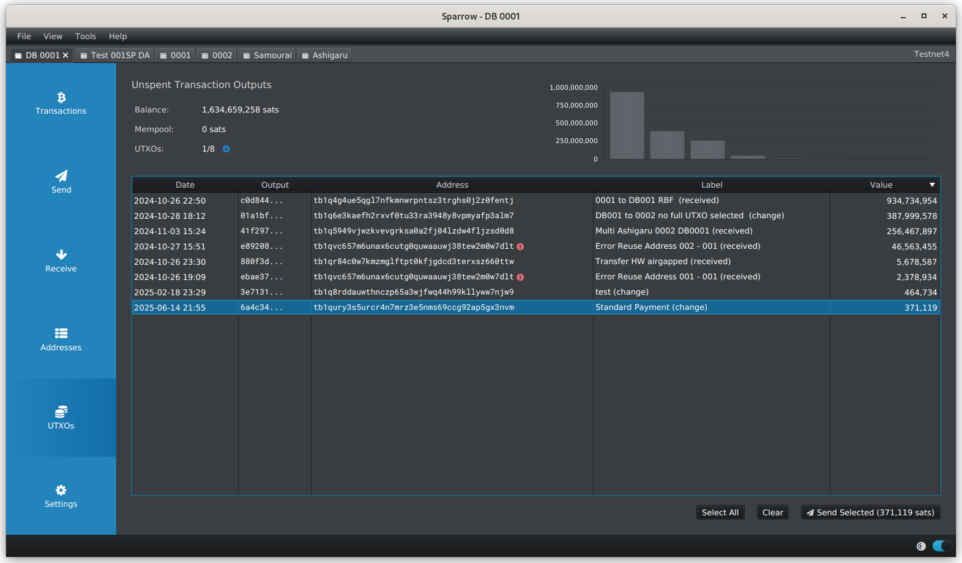
[xTx]

Slide 21

[xTx]

Slide 22
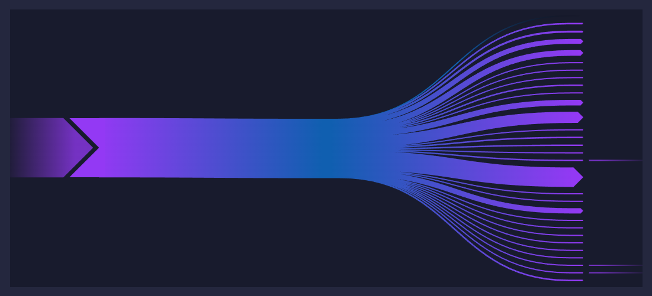
Batch payments
One or few inputs and several Outputs
[xTx]

Slide 23
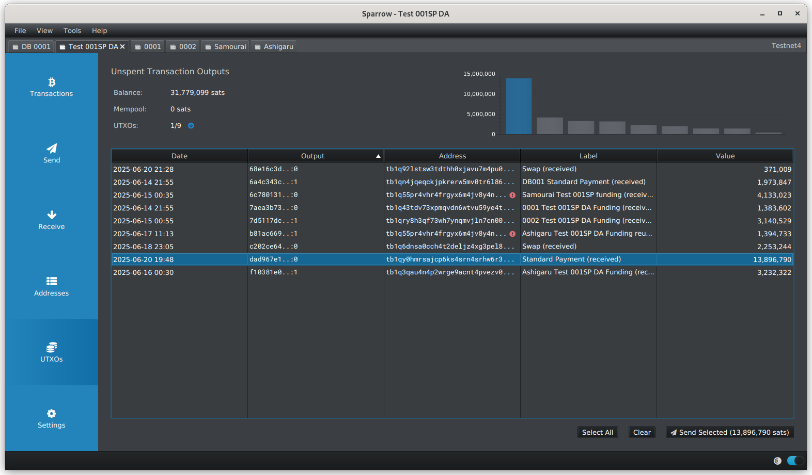
[xTx]

Slide 24
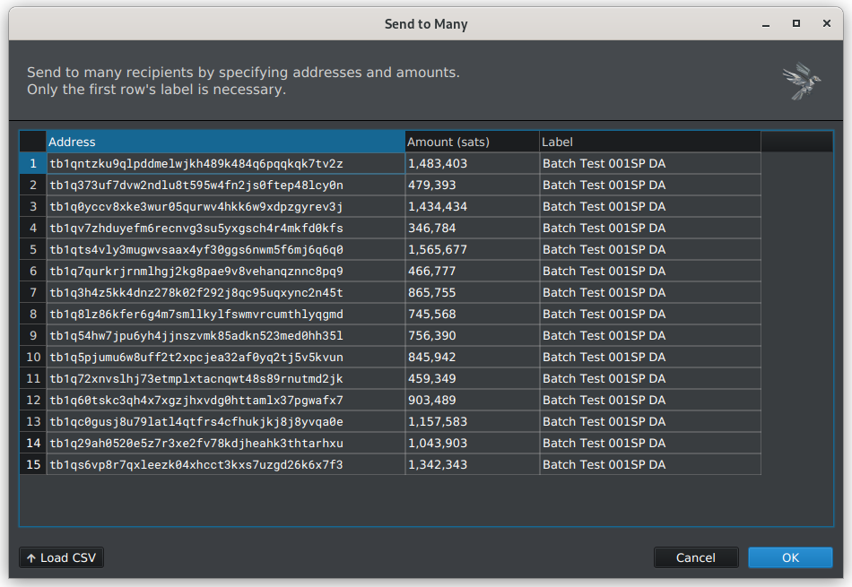
[xTx]

Slide 25
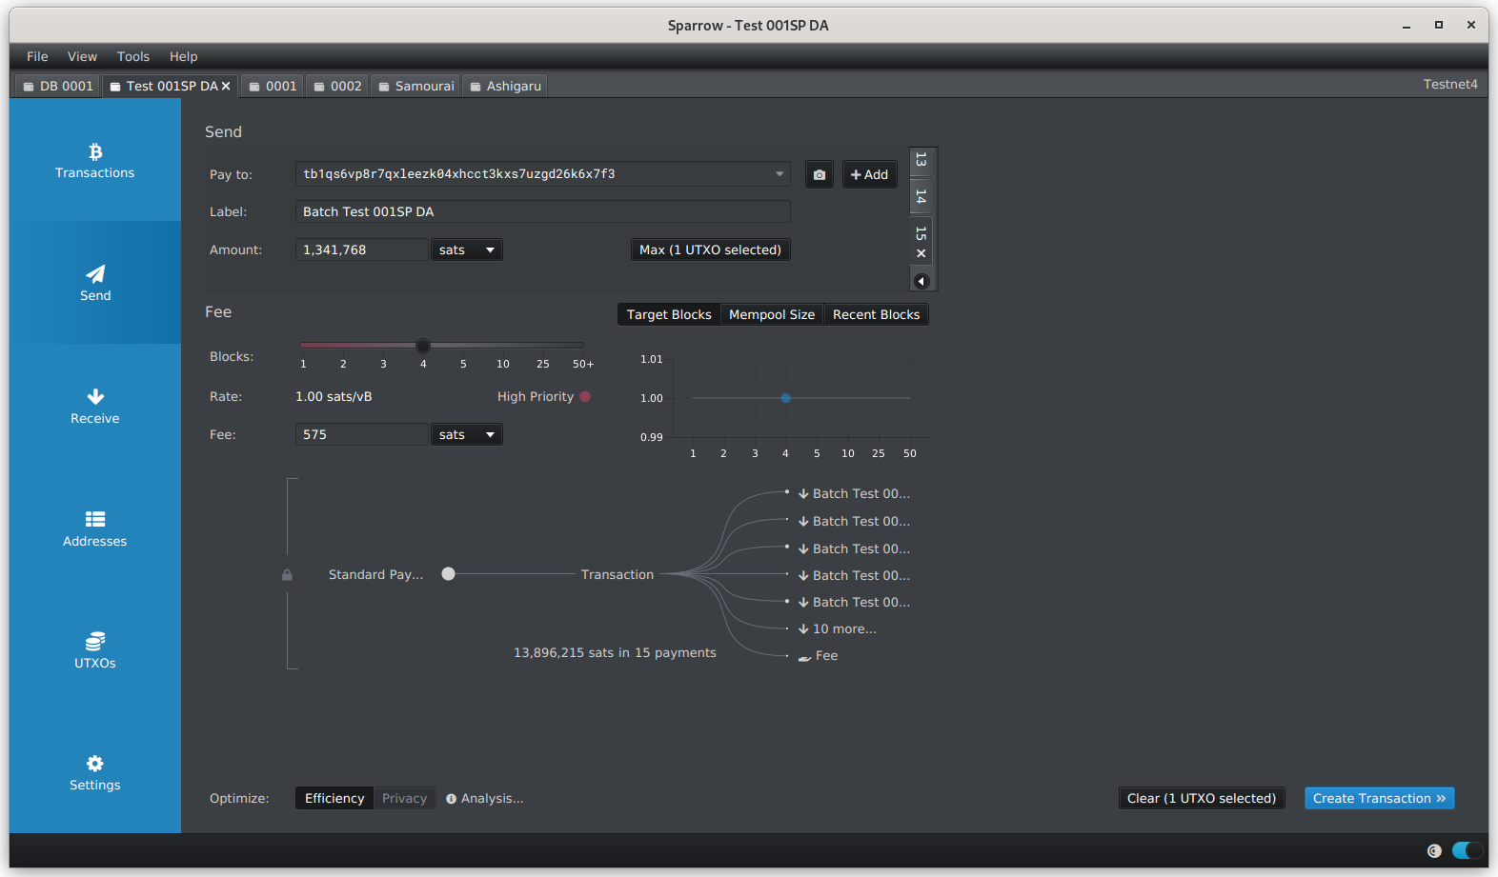
[xTx]

Slide 26
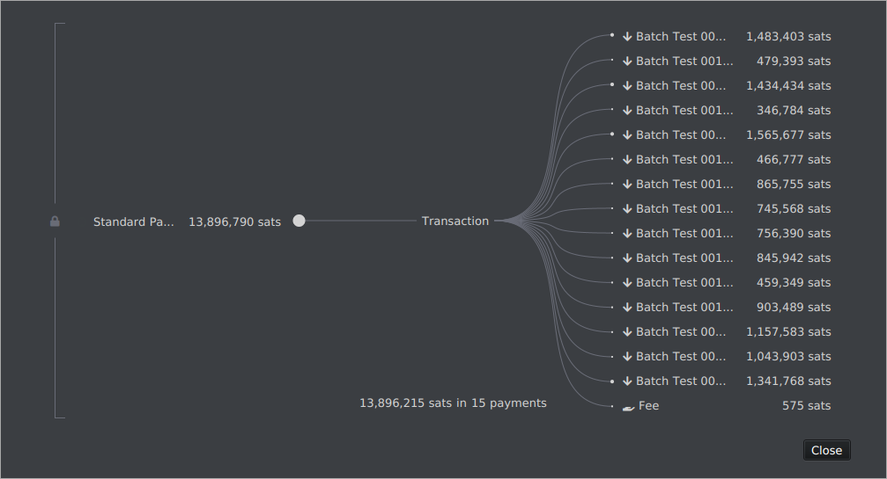
[xTx]

Slide 27
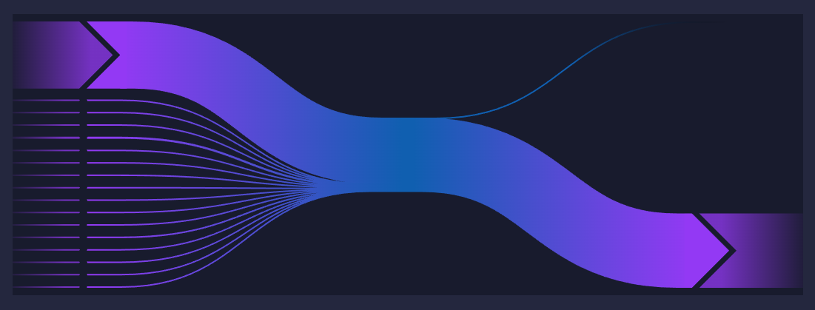
Consolidation Self transfer
One or more inputs - One output
[xTx]

Slide 28
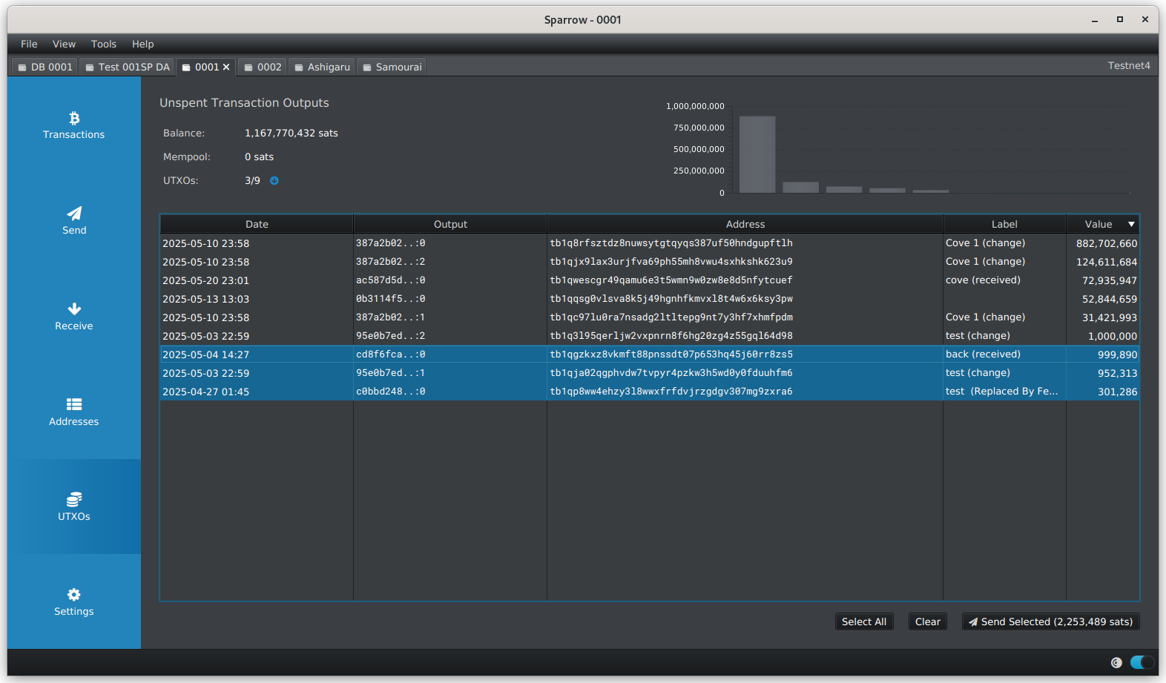
[xTx]

Slide 29

[xTx]

Slide 30
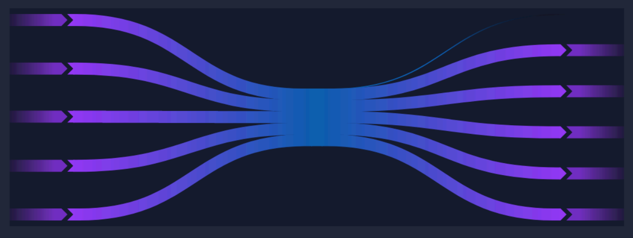
Coinjoin
Several inputs and outputs
[xTx]

Slide 31
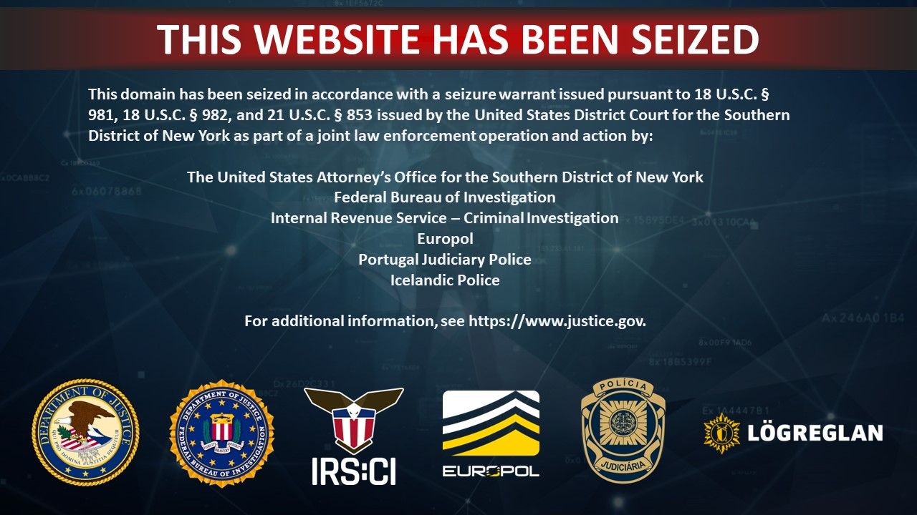

Slide 32
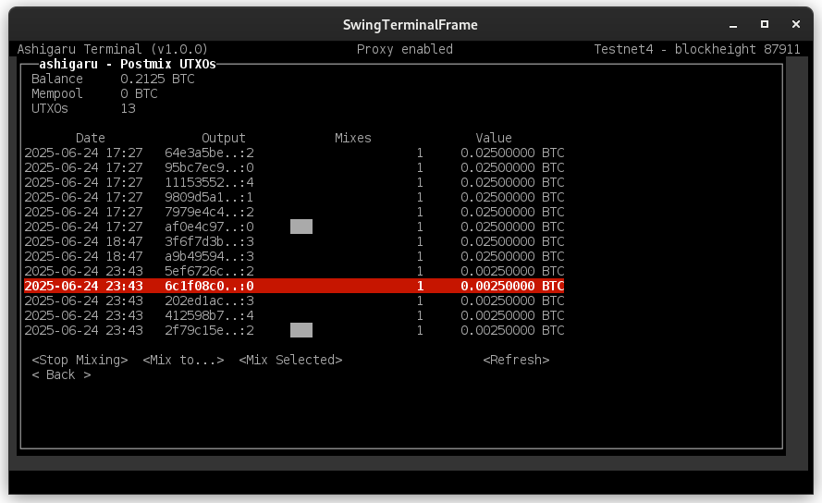
[xTx]

Slide 33
[xTx]

